Slide 1
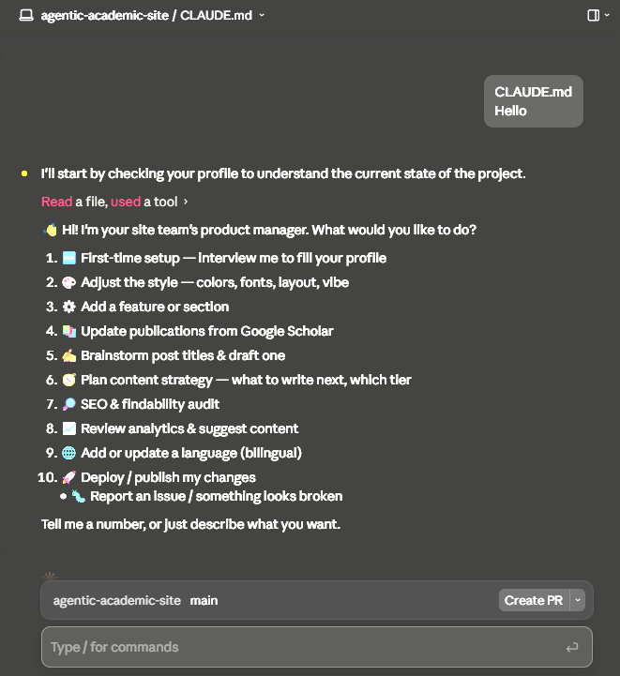
Agentic Academic Site Point your AI agent at it. Get your academic website in an hour.
Human (You + Your AI)
Input command.
“Make me an academic site.”
00_profile
Your facts: CV, résumé, publication, achievements, cover letters, SOP. The team reads here.
product-manager
Orchestrates the team.
content-strategist
Chief editor who routes content plan.
web-designer
Turn vague aesthetics into CSS; dark/light.
growth-marketer
SEO, GEO, and analytics; sitemap.
site-engineer
Build, wire JS and includes, deploy, validate.
Shared skills
interview-user, scholar-import, SEO-audit … (reused across agents).
edchen1240
01_www
Your live academic website.
Features
Easy Start
📱 Responsive layout from one CSS-variable system.
🌗 Dark / light toggle (remembers your choice).
🌐 Bilingual English / 繁體中文 toggle.
🔎 SEO baked in — JSON-LD schema, sitemap, meta tags.
📈 Privacy-friendly analytics (GoatCounter, no cookies).
📝 Posts / projects / materials from simple JSON.
🤖 An AI agent team that customizes the whole thing for you.
⚙️ Vanilla HTML/CSS/JS — no build step, deploy anywhere.
👉 https://github.com/edchen1240/agentic-academic-site

Slide 2
Agentic Academic Site - Overview
Human (You + Your AI)
Input command.
“Make me an academic site.”
00_profile
Your facts: CV, résumé, publication, achievements, cover letters, SOP. The team reads here.
product-manager
Orchestrates the team.
content-strategist
Chief editor who routes content plan.
web-designer
Turn vague aesthetics into CSS; dark/light.
growth-marketer
SEO, GEO, and analytics; sitemap.
site-engineer
Build, wire JS and includes, deploy, validate.
Shared skills
interview-user, scholar-import, SEO-audit … (reused across agents).
edchen1240
01_www
Your live academic website.

Slide 3
Agentic Academic Site – How to Start and Evolve
Answer the interview questions or discuss details with agent.
To Start
Point your agent at AGENTS.md and describe the change you want.
Deploy to GitHub Pages or any host. Record progress in P00_Project Progress.md.
Fork or Clone this repo.
Evolve Loop
edchen1240
Want to change something (artistic style, content update).

Slide 4
Agentic Academic Site - Post Writing Workflow
Stage I-A:
Post Writing Workflow – Markdown (fast production)
Human
Read / Edit
Stage-II
Deployment Pipeline
git sync
Local .md
Article Editing
/ MD preview
.md to .html
GitHub
Canonical
AI Agent
Collaboration
edchen1240
git push
git pull
Stage I-B:
Post Writing Workflow – LaTeX (better citation management)
Local
Editing area
Institute Server
Deployment
Human
Read / Edit
Overleaf .pdf
Article Preview
edchen1240
git sync
AI Agent
Collaboration
Local .tex
Article Editing
.tex to .html

Slide 5
Calibri Light, 32-36, Bold Calibri Light, 20-24, Normal
Dimension:3.0, 30.0
Position: 1.0, 0.8
Calibri, 16-24, Normal (H=13, W=30, x=1, y=3.8)
Dimension:3.0, 30.0
Position: 1.0, 0.8

